Slide 1

Internet of Things (IoT)
Resourcing the event
Guillermo Ramirez-Prado

Slide 2
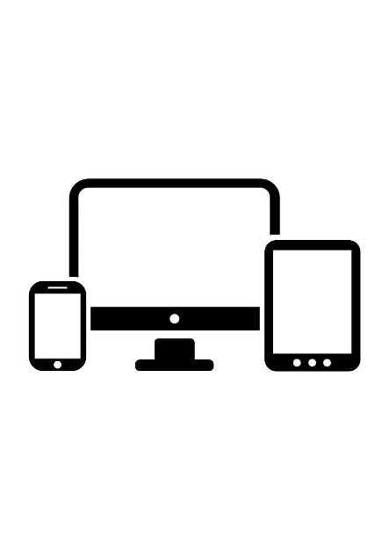

A general framework
LAN
WiFi/Ethernet
Interface
(TCP/IP)
Actuators
Microprocesor
+ minimal system
+ web server
Sensors

Slide 3


IP: 192.168.1.x
device
IP:192.168.1.x
device
IP:192.168.1.x
device
IP:192.168.1.x
device
IP:192.168.1.x
device
IP:192.168.1.x
device
IP:192.168.1.x
device
IP:192.168.1.x
device
IP:192.168.1.x
device
IP:192.168.1.x
device
IP:192.168.1.x
device
IP:192.168.1.x

Slide 4
LAN
device
IP:192.168.1.x

Slide 5
MQTT

Slide 6
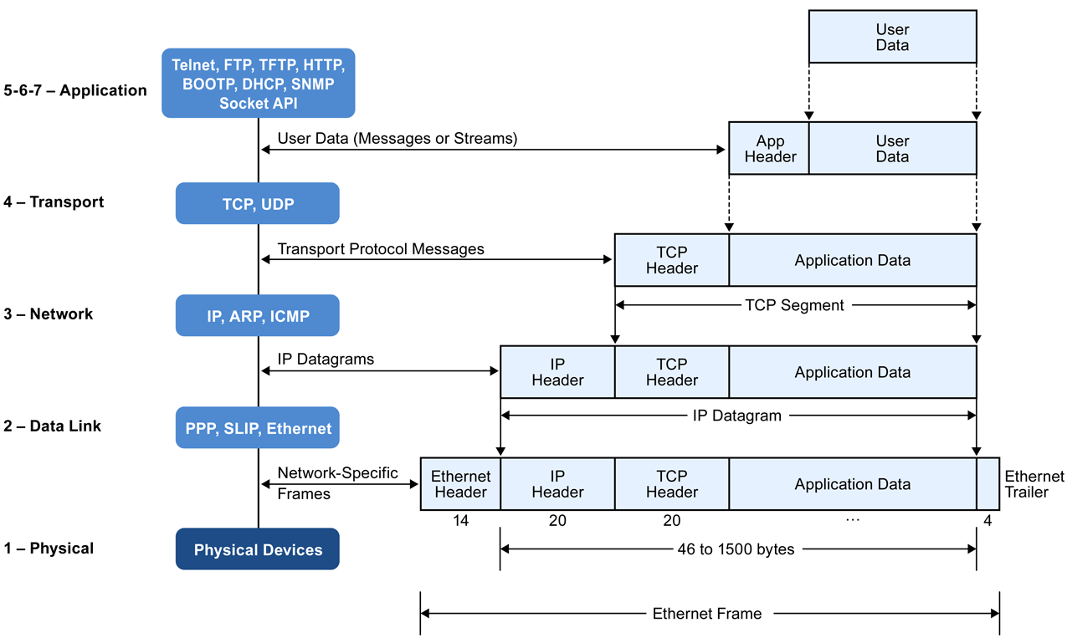

Slide 7
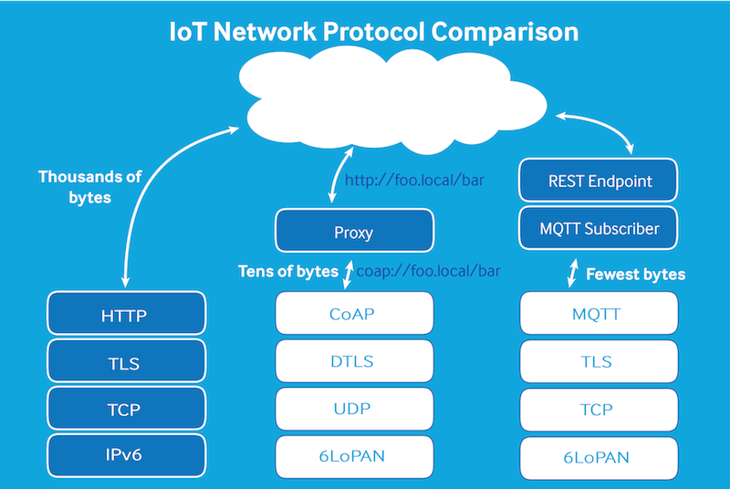
MQTT and CoAP

Slide 8
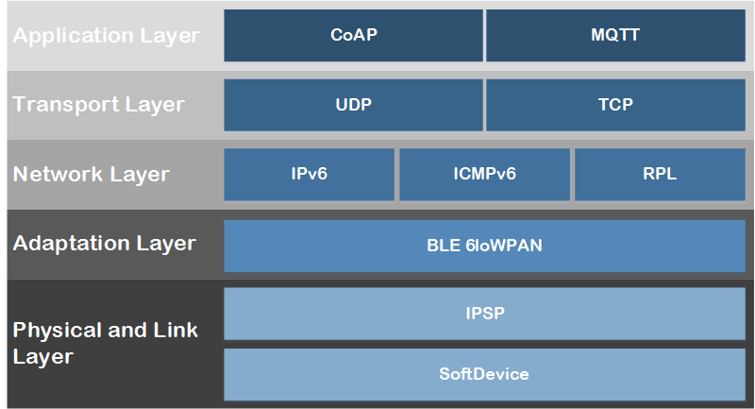
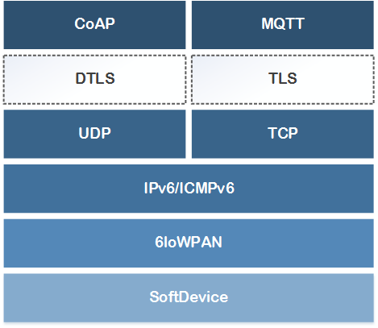
MQTT and CoAP

Slide 9
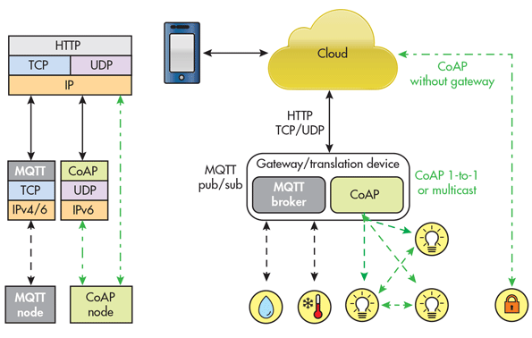

Slide 10
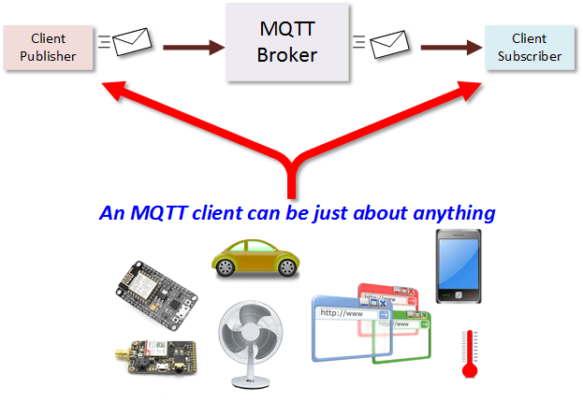

Slide 11
MQTT
LAN
MQTT
TCP/IP
IBM’s Message Queuing
Telemetry Transport
Device
IP:192.168.1.x

Slide 12
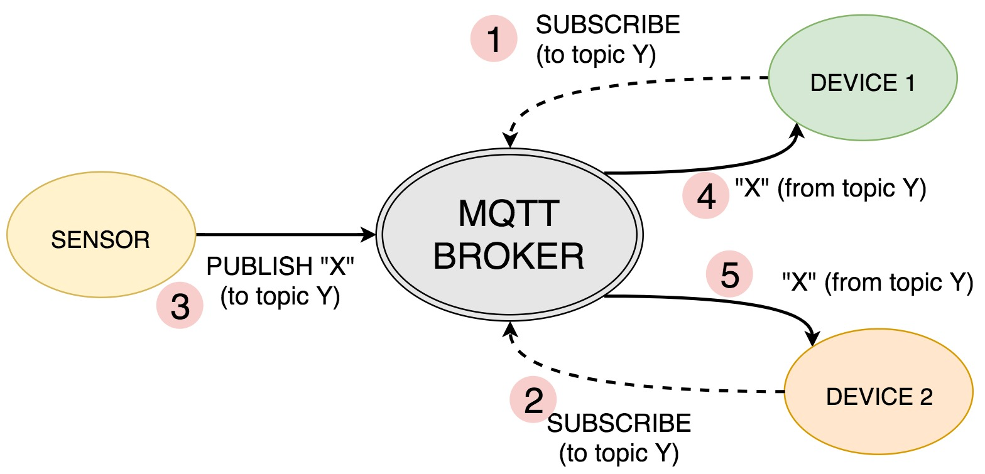

Slide 13

MQTT
LAN
Subscribe to signal1
And signal2
Publish signal2
Publish signal1
Device
IP:192.168.1.x
MQTT
Broker
Device
IP:192.168.1.x

Slide 14

LAN

Slide 15
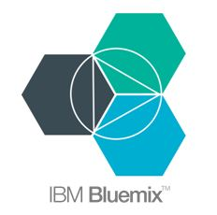
Clouds
Private cloud
LAN
Hybrid
cloud
Public
cloud
MQTT
Broker
Device
IP:192.168.1.x

Slide 16
Private Cloud
MQTT
Broker
Device
IP:192.168.1.x

Slide 17
MQTT
Broker
Device
IP:192.168.1.x

Slide 18
IoT Brokers
Suscription (on demand)
IBM Cloud
Online public brokers
HiveMQ
cloudMQTT
Eclipse
CloudMQ
EasyIoT
Thinkspeak
MQTT Broker App (Android)

Slide 19
OpenSource
MosQuiTTo
VerneMQ

Slide 20
MQTT Clients
MQTT.fx
Mqtt-spy
HiveMQ Client
MyMQTT (Android, iOS)
MQTT Dash (Android)
MQTT Buddy (iOS)
MQTT inspector

Slide 21
Activity
Set up a public broker
Use a client to connect to public broker

Slide 22
Network protocol analyzer
Wireshark

Slide 23
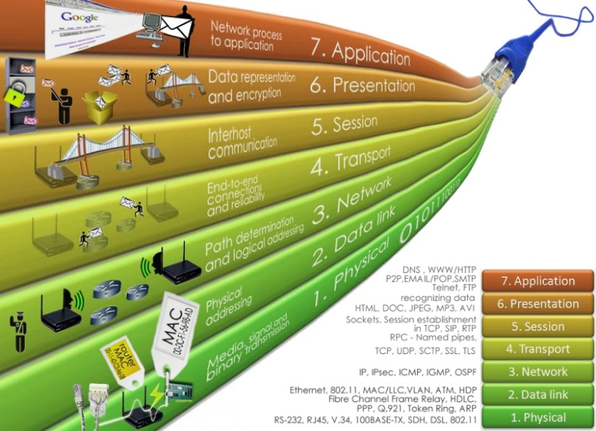
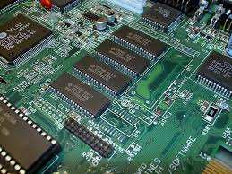
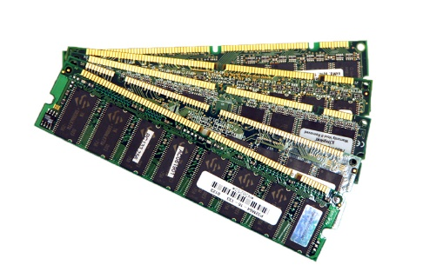
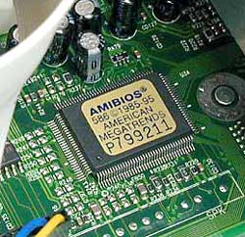
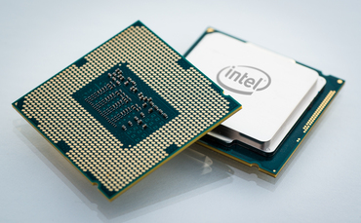
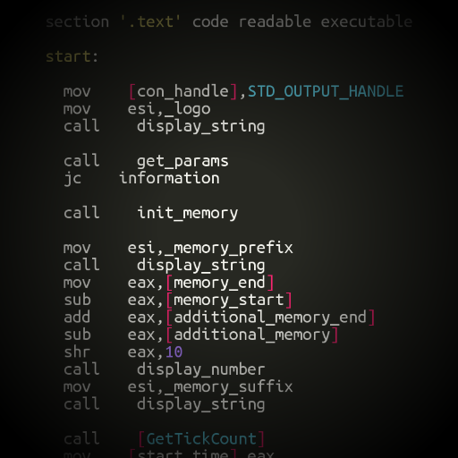
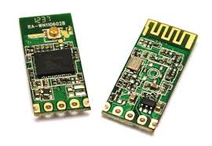
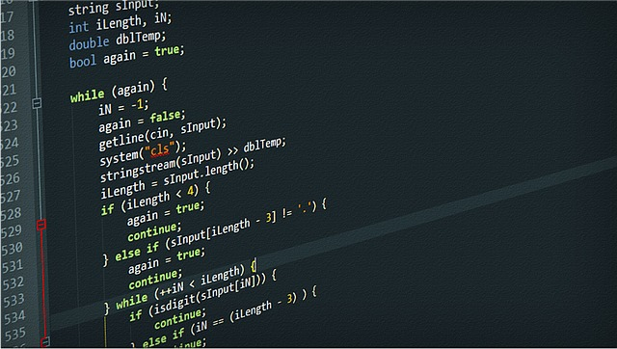
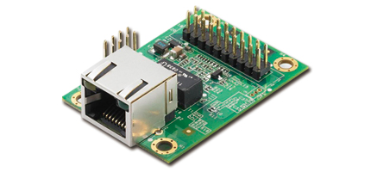
IoT devices

Slide 24



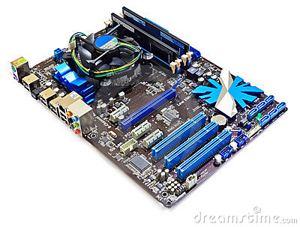
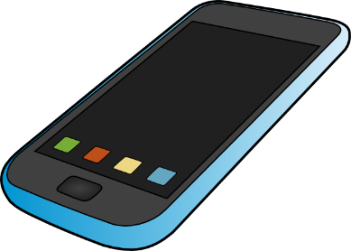
IoT devices Computers, tablets, smartphones

Slide 25
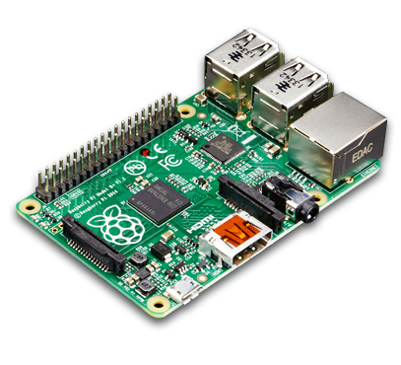
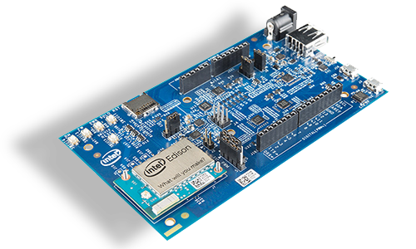
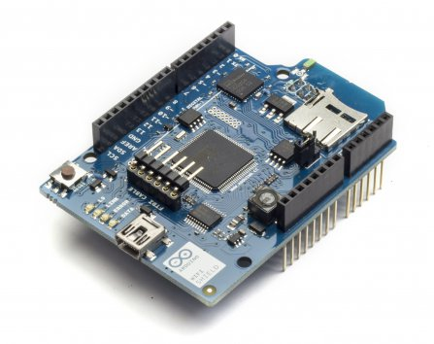
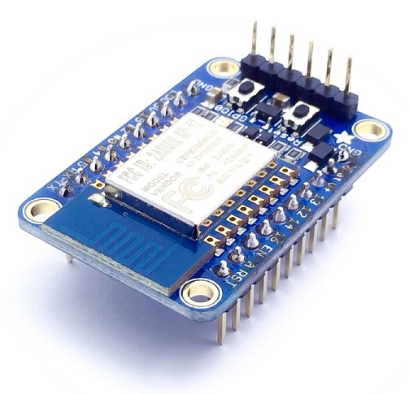
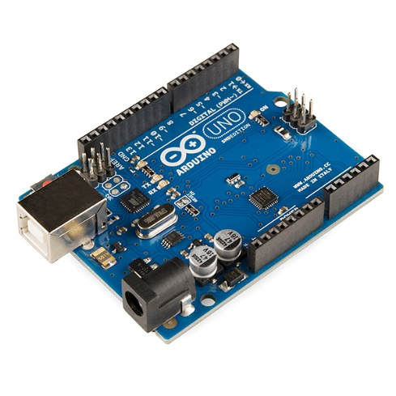
IoT devices Embedded systems

